Slide 1
Systèmes de Gestion de Bases de Données (SGBD)
Administration de base de données
ENI-ABT
M2-MSI
Présenté par Drissa Sidiki Traoré & Pascal Diarra
Encadré par Dr. Yacouba Goïta

Slide 2
Objectif
Ce TP a pour but de mettre en pratique les fondamentaux du langage SQL à travers deux volets :
1. Manipulation des données relationnelles (requêtes SELECT, jointures, agrégats, etc.),
2. Gestion des droits d’accès via le DCL (création d’utilisateurs, rôles et attribution de privilèges).

Slide 3
Structure des données
Le modèle relationnel portait sur une structure de gestion de cours et de formations, intégrant des entités comme :
• Animateurs
• Cours
• Participants
• Thèmes
• Entreprises
• Catégories
• Et les tables associatives Animer et Participer

Slide 4
Structure des données
Le Modèle Relationnel de Donnée (MRD) se présente comme suit :
• Animateurs(matricule_animateur*(char(4), nom(varchar(30)), prénom(varchar(30)),)
• Cours(code_cours*(char(4)), niveau(varchar(35), date_cours(date), tarif_hr(integer), prime_resp(integer), droit_inscrip(integer), code_theme(char(4)), matricule_animateur(char(4)),)
• Animer(code_cours*(char(4)), matricule_animateur*(char(4)), nbre_heures(integer)
• Participants(matricule*(char(4)), nom(varchar(35), prénom(varchar(35), localité(varchar(35), code_entreprise (integer))

Slide 5
Structure des données
• Catégories(code_catégorie*(char(4),libellé(varchar(35),)
• Participer(code_cours*(char(4)), matricule) *(char(4))
• Entreprises(code_entreprise*(char(4)), nom(varchar(35),), adresse(varchar(35),))
• Thème(code_thème**(char(4)), désignation(varchar(35),), code_catégorie*(char(4))
Toutes les données de test, ainsi que la structure des tables utilisées dans ce TP, nous ont été fournies par le professeur afin d'assurer un cadre cohérent et standardisé pour les exercices.

Slide 6
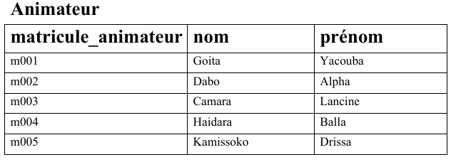
Données de test

Slide 7
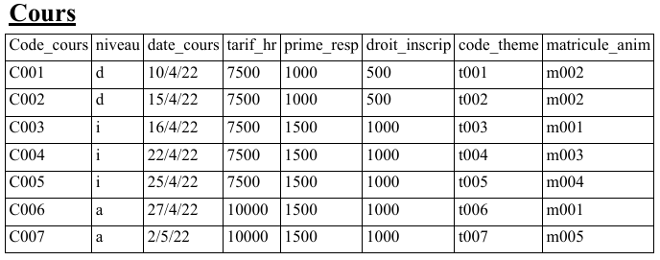
Données de test

Slide 8
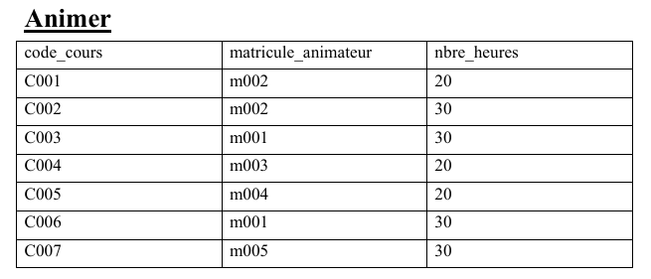
Données de test

Slide 9
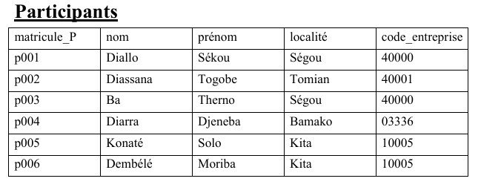
Données de test

Slide 10
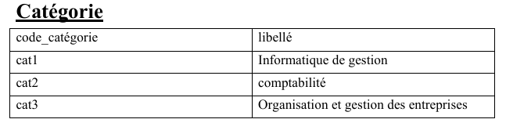
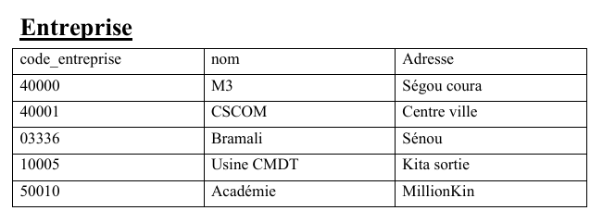
Données de test

Slide 11
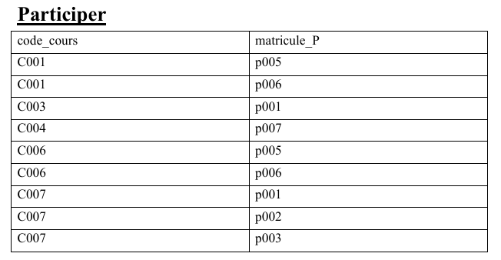
Données de test

Slide 12
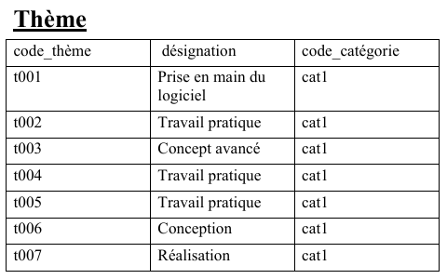
Données de test

Slide 13



Outils utilisés
Pour la réalisation de ce TP, nous avons utilisé XAMPP accompagné de son interface phpMyAdmin, afin de gérer la base de données et exécuter les requêtes SQL dans un environnement local.
Le cas de démonstration se fera avec le logiciel MySQL Workbench

Slide 14
01
Systèmes de Gestion de Bases de Données (SGBD)
x
y

Slide 15
Objectif
Cette première partie du TP1 en Systèmes de Gestion de Bases de Données (SGBD) a pour objectif de manipuler une base de données relationnelle en SQL à travers des requêtes d’interrogation, de tri, de filtrage et d’agrégation, le tout basé sur un modèle relationnel bien défini.
Le TP s’inscrit dans une logique de mise en pratique des notions fondamentales de SQL : SELECT, WHERE, GROUP BY, ORDER BY, JOIN, AVG, COUNT, HAVING, etc.

Slide 16
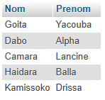
Requêtes SQL réalisées
1. Requête 1 : Afficher le nom et le prénom de tous les animateurs.
SELECT Nom, Prenom FROM animateur;
Résultat :

Slide 17
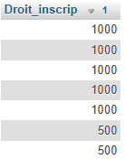
Requêtes SQL réalisées
2. Requête 2 : Afficher les différents droits d’inscription suivant l’ordre décroissant.
SELECT Droit_inscrip
FROM cours
ORDER BY `Droit_inscrip` DESC;
Résultat :

Slide 18

Requêtes SQL réalisées
3. Requête 3 : Afficher le code entreprise, les noms et prénoms des participants venant de l’entreprise dont le code est 3336.
SELECT `Code_entreprise`, `Nom`, `Prenom`
FROM participants
WHERE `Code_entreprise`=3336;
Résultat :

Slide 19

Requêtes SQL réalisées
4. Requête 4 : Afficher les matricules des animateurs responsables et la date des cours qui ont eu lieu entre le 03Avril et le 15 Avril 2022.
SELECT `Matricule_anim`, `Date_cours`
FROM cours
WHERE `Date_cours` BETWEEN '2022-04-03' AND '2022-04-15';
Résultat :

Slide 20
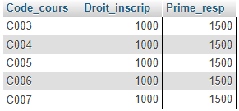
Requêtes SQL réalisées
5. Requête 5 : Afficher les codes cours, le droit d’inscription et la prime de responsabilité des cours dont le droit d’inscription est en dessous de 6000 F et la prime de responsabilité est supérieure à 1000 F
SELECT `Code_cours`, `Droit_inscrip`, `Prime_resp`
FROM cours WHERE `Droit_inscrip`<6000 AND `Prime_resp` > 1000;
Résultat :

Slide 21

Requêtes SQL réalisées
6. Requête 6 : Afficher tous les noms et prénoms des participants dont le nom se termine avec la lettre N trié suivant l’ordre alphabétique des noms et prénoms.
SELECT `Nom`, `Prenom`
FROM participants WHERE `Nom` LIKE '%N'
ORDER BY `Nom`, `Prenom` ASC;
Résultat : Dans la source de donnée initiale, il n’existe aucun nom se terminant par N. Pour s’assurer que la requête fonctionne correctement, on a dû modifier le nom du participant p004 pour qu’il se termine par N.

Slide 22

Requêtes SQL réalisées
7. Requête 7 : Afficher tous les noms et prénoms des participants dont les 2e et 3e lettres du nom sont respectivement C et H.
SELECT `Nom`, `Prenom`
FROM `participants`
WHERE SUBSTRING(`Nom`, 2, 2) = 'ch';
Résultat : Dans la source de donnée initiale, il n’existe aucun non dont son 2e et 3e lettre sont respectivement C et H, on a dû modifier les noms des participants p001 et p002 pour s’assurer que la requête fonctionne correctement.

Slide 23

Requêtes SQL réalisées
8. Requête 8 : Quel est le nombre de cours organisés ?
SELECT COUNT(*) AS Nb_cours FROM `cours`;
Résultat :

Slide 24

Requêtes SQL réalisées
9. Requête 9 : Calculer la moyenne des droits d’inscription, des primes de responsabilité et des tarifs heure.
SELECT
AVG(`Droit_inscrip`) AS Moy_Droit_inscrip,
AVG(`Prime_resp`) AS Moy_Prime_resp,
AVG(`Tarif_hr`) AS Moy_Tarif_hr
FROM `cours`;
Résultat :

Slide 25

Requêtes SQL réalisées
10. Requête 10 : Combien de cours organise-t-on pour chaque niveau ?
SELECT `Niveau`, COUNT(`Code_cours`) AS Nb_cours
FROM `cours`
GROUP BY `Niveau`;
Résultat :

Slide 26
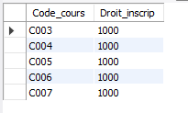
Requêtes SQL réalisées
11. Requête 11 : Quel est le code du cours dont le droit d’inscription est le plus élevé ?
SELECT `Code_cours`, `Droit_inscrip`
FROM `cours` WHERE `Droit_inscrip` =
(SELECT MAX(`Droit_inscrip`) FROM cours);
Résultat :

Slide 27

Requêtes SQL réalisées
12. Requête 12 : Calculer le total des heures prestées par l’animateur ayant le numéro matricule 19800202222.
SELECT SUM(an.nbre_heures) AS Total_heures
FROM animateur a
JOIN animer an ON an.matricule_animateur = a.Matricule
WHERE a.Matricule = 'm001'
GROUP BY a.Matricule, a.Nom, a.Prenom;
Résultat : Il n’existe aucun animateur ayant le numéro matricule 19800202222. Pour s’assurer que la requête fonctionne correctement on a dû changer 19800202222 en un numéro matricule existant dans la table (m001).

Slide 28
01
Computer graphics
02
Software and media apps
03
Data modeling/warehousing
04
Modeling, virtual environments
05
Digital & inf. resources design
You can describe the topic of the section here
You can describe the topic of the section here
You can describe the topic of the section here
You can describe the topic of the section here
You can describe the topic of the section here

Slide 29
Introduction
Mercury is the closest planet to the Sun and the smallest one in the Solar System—it’s only a bit larger than the Moon

Slide 30
—Someone Famous
“This is a quote, words full of wisdom that someone important said and can make the reader
get inspired.”

Slide 31
The slide title goes here!
Do you know what helps you make your point clear? Lists like this one:
They’re simple
You can organize your ideas clearly
You’ll never forget to buy milk!
And the most important thing: the audience won’t miss the point of your presentation

Slide 32
Explore computer science
Theory
Design
Mercury is the closest planet to the Sun and the smallest in the Solar System
Despite being red, Mars is actually a cold place. It’s full of iron oxide dust

Slide 33

A picture is worth a thousand words

Slide 34
Whoa!
This can be the part of the presentation where you introduce yourself, write your email…

Slide 35
Computer graphics packages
Mercury
Venus
Mars
It’s the closest planet to the Sun and the smallest
Venus is the second planet from the Sun
Despite being red, Mars is actually a cold place

Slide 36
02
Computer software and media applications
404 NOT FOUND
You can enter a subtitle here if you need it

Slide 37
Job title examples
App developer
Systems engineer
Software engineer
Computer programmer
Mercury is the closest planet to the Sun and the smallest
Venus has a beautiful name, but also high temperatures
Earth is the third planet from the Sun and has life
Despite being red, Mars is actually a cold place

Slide 38
Professional areas
 | Freelancer | Employee
Professional, scientific and tech.
Publishing industries
Electronic product manufacturing
Insurance and related activities
Management of companies

Slide 39
What courses to take?
Computational
Computer app
Mercury is the smallest planet
Jupiter is the biggest planet
Development
Programming
Despite being red, Mars is a cold place
Venus has a beautiful name
Mathematics
Statistics
Neptune is far away from Earth
Earth is a planet that has life

Slide 40
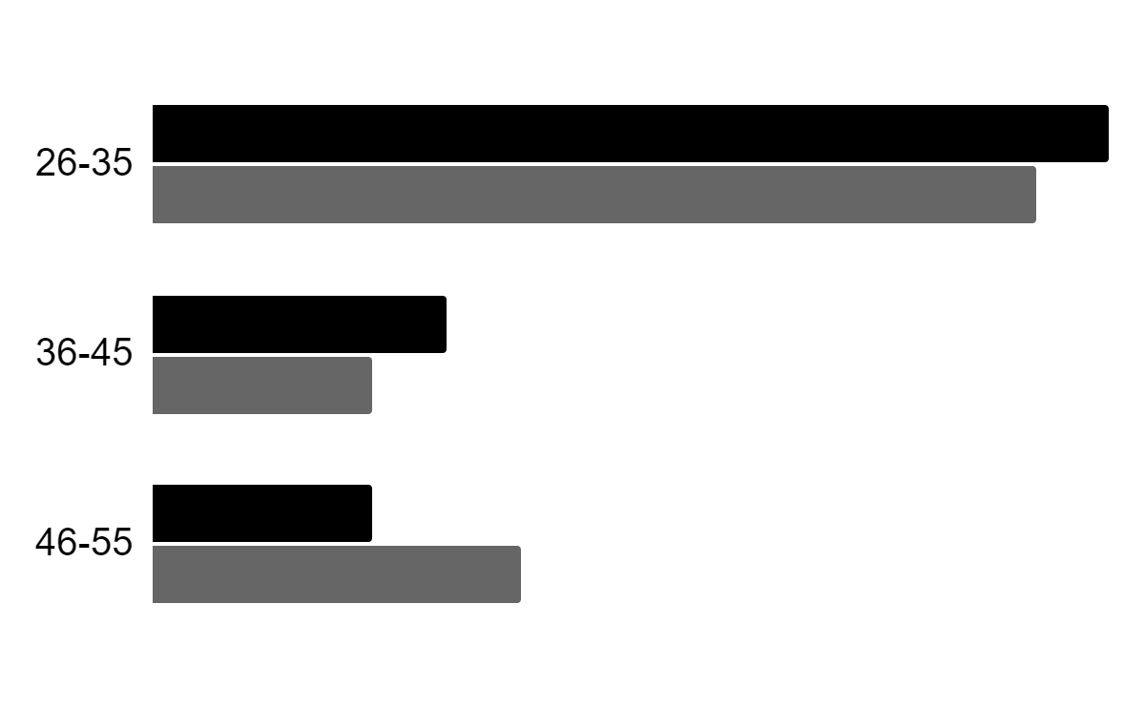
Labor insertion
Gender
Age
60%
40%
Interests
Women
Men
Follow the link in the graph to modify its data and then paste the new one here. For more info, click here

Slide 41
Where are professionals needed?
Venus
Jupiter
Venus has a beautiful name
Jupiter is the biggest planet
65%
85%
50%
75%
Mars
Saturn
Mars is a very cold place
Saturn is the ringed planet

Slide 42
What are other related majors?
Option A
Option B
Saturn is a gas giant and has several rings
Neptune is the farthest planet from the Sun
The Sun is the star at the center of the Solar System
Venus is the second planet from the Sun
Despite being red, Mars is a cold place
Jupiter is the biggest planet in the Solar System

Slide 43
03
Data modeling / warehousing database administration
You can enter a subtitle here if you need it

Slide 44
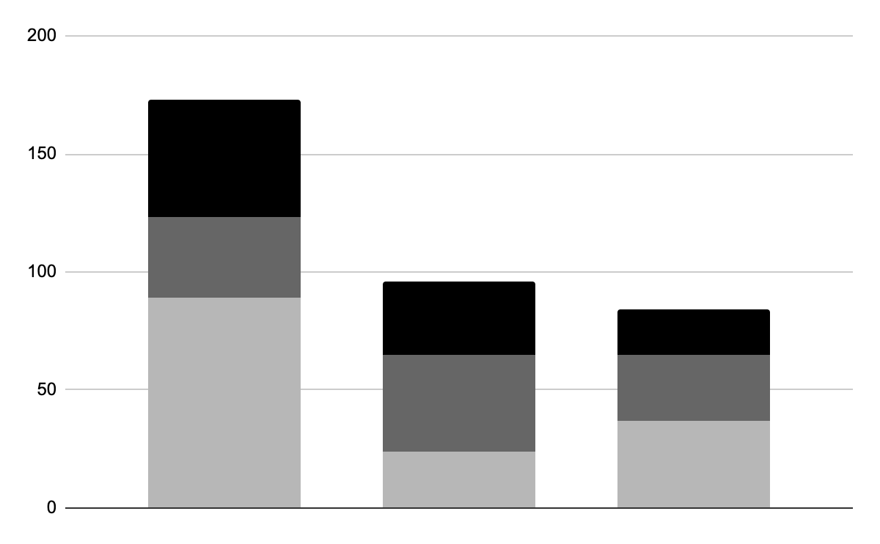
Graph about database admin.
Mercury
It’s the closest planet to the Sun
Mars
Mars is actually a very cold place
Neptune
2020
2021
2022
Neptune is far away from Earth
Follow the link in the graph to modify its data and then paste the new one here. For more info, click here

Slide 45
150,000
Big numbers catch your audience’s attention

Slide 46
9h 55m 23s
333,000
386,000 km
Jupiter's rotation period
The Sun’s mass compared to Earth’s
Distance between Earth and the Moon

Slide 47
What courses to take?
Accounting
Networks
Programming
Logic
Semantics
Architecture
Mercury is a very small planet
Venus has a beautiful name
Mars is actually a very cold place
Jupiter is the biggest planet
Saturn is the ringed planet
Neptune is far away from Earth

Slide 48
04
Modeling, virtual environments and simulation
You can enter a subtitle here if you need it

Slide 49
Our major program
Despite being red, Mars is cold
It’s the closest planet to the Sun
Mars
Mercury
2022
2023
2024
2025
Jupiter
Saturn
It’s the biggest planet of them all
It’s composed of hydrogen and helium

Slide 50
Best modeling courses
Venus
Jupiter
Venus is the second planet from the Sun
It’s the biggest planet in the Solar System
Saturn
Mercury
Saturn is a gas giant and has several rings
Mercury is the closest planet to the Sun

Slide 51
Employments in this sector
25%
50%
25%
Modeling
Virtual
Simulation
Mars is actually a very cold place
Neptune is far away from Earth
Mercury is quite a small planet

Slide 52
Awesome words

Slide 53
Study schedule
Days | 01 | 02 | 03 | 04 | 05 | 06 | 07 | 08 | 09 | 10 | 11 | 12 | 13 | 14 | 15
Task 1
Task 2
Days | 16 | 17 | 18 | 19 | 20 | 21 | 22 | 23 | 24 | 25 | 26 | 27 | 28 | 29 | 30
Task 1
Task 2
Available
No available

Slide 54

A picture always reinforces the concept
Images reveal large amounts of data, so remember: use an image instead of a long text. Your audience will appreciate it

Slide 55

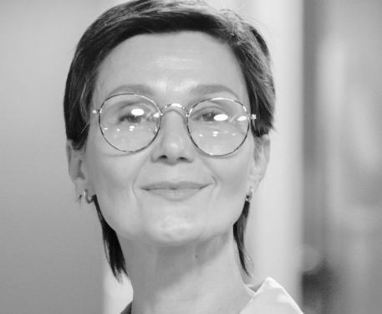
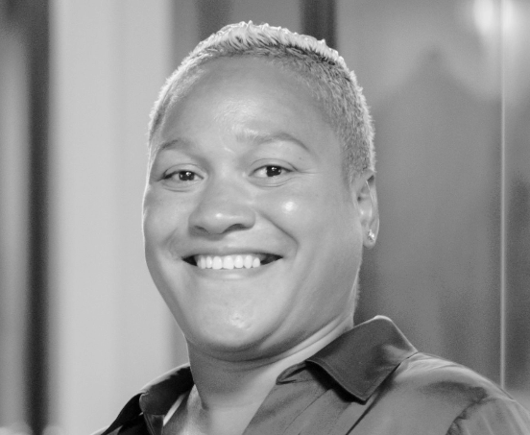
Our department
Timmy Jimmy
Susan Bones
John Doe
You can replace the image on the screen with your own
You can replace the image on the screen with your own
You can replace the image on the screen with your own

Slide 56
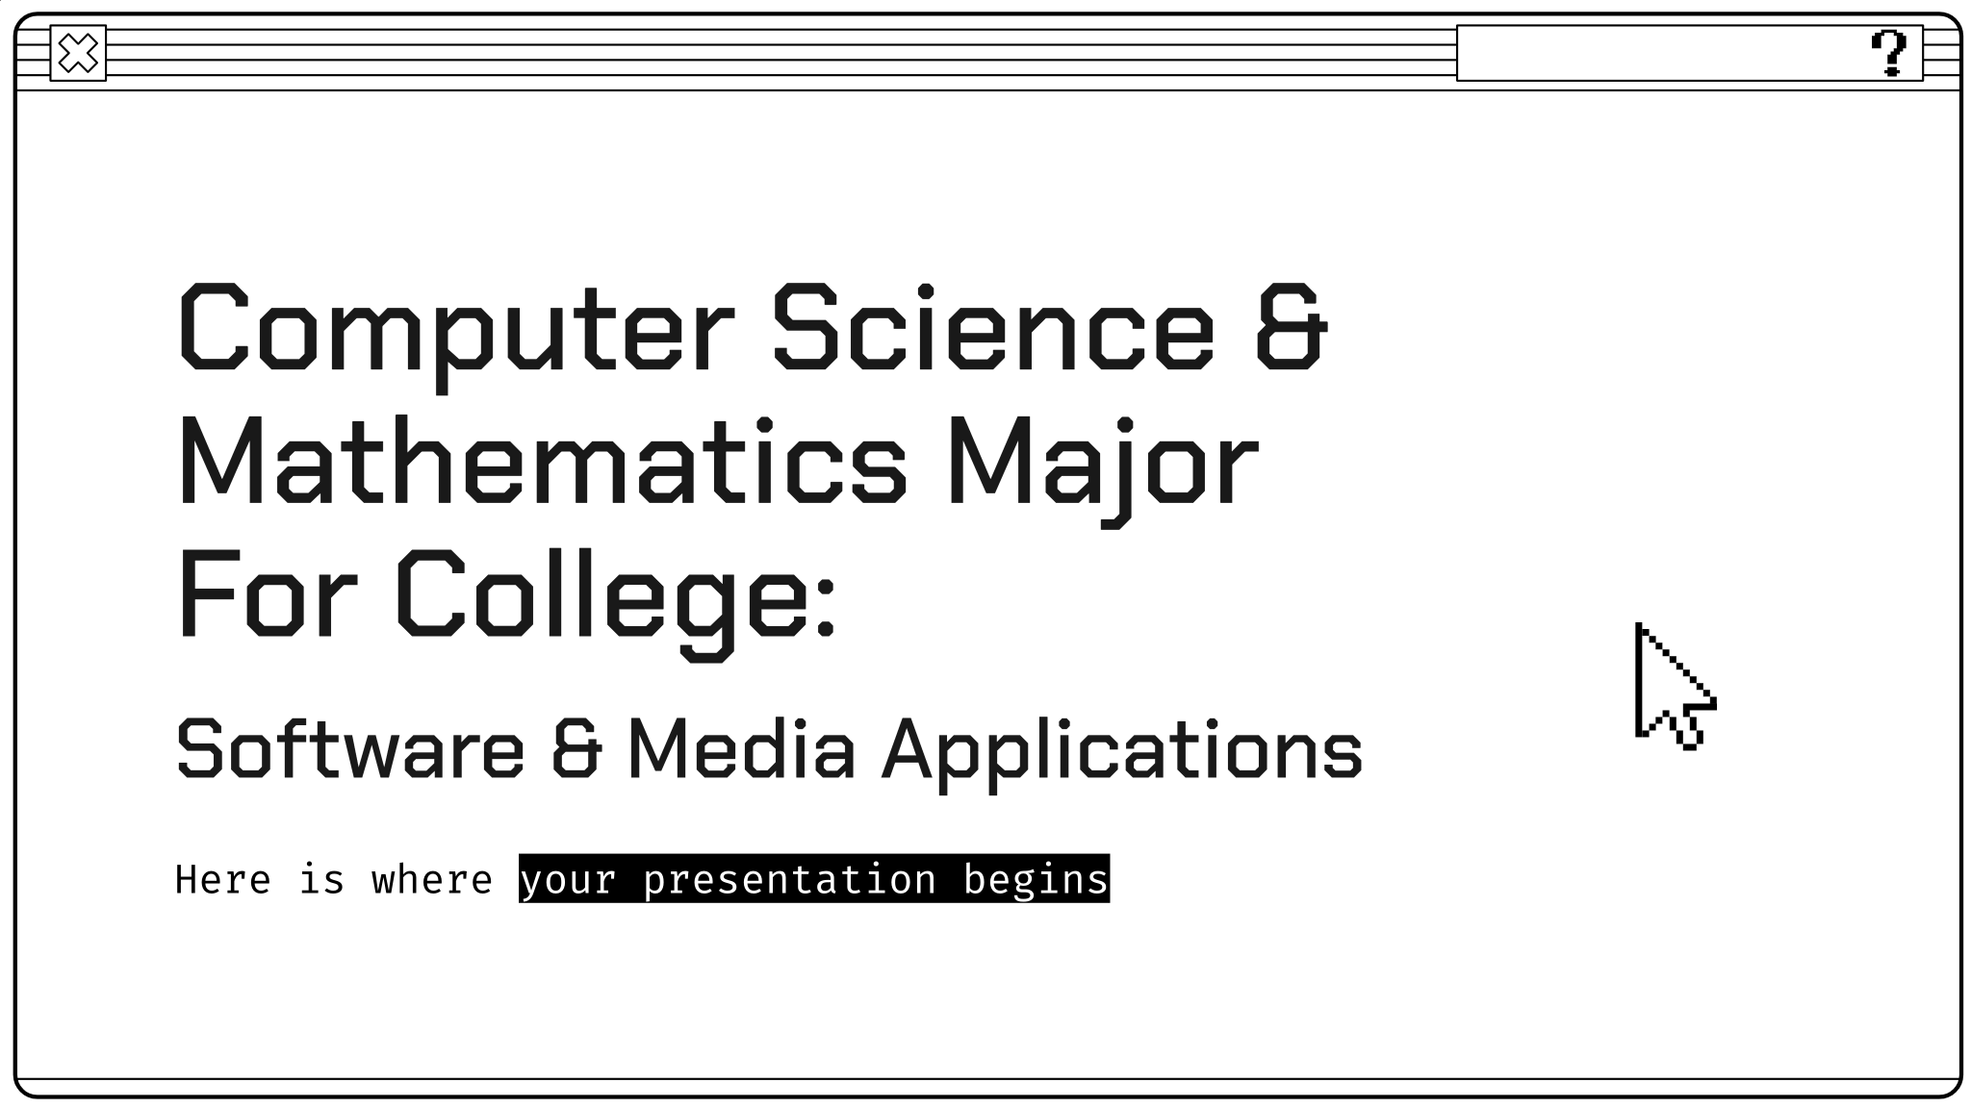
Enrollment platform
You can replace the image on the screen with your own work. Just right-click on it and select “Replace image”

Slide 57
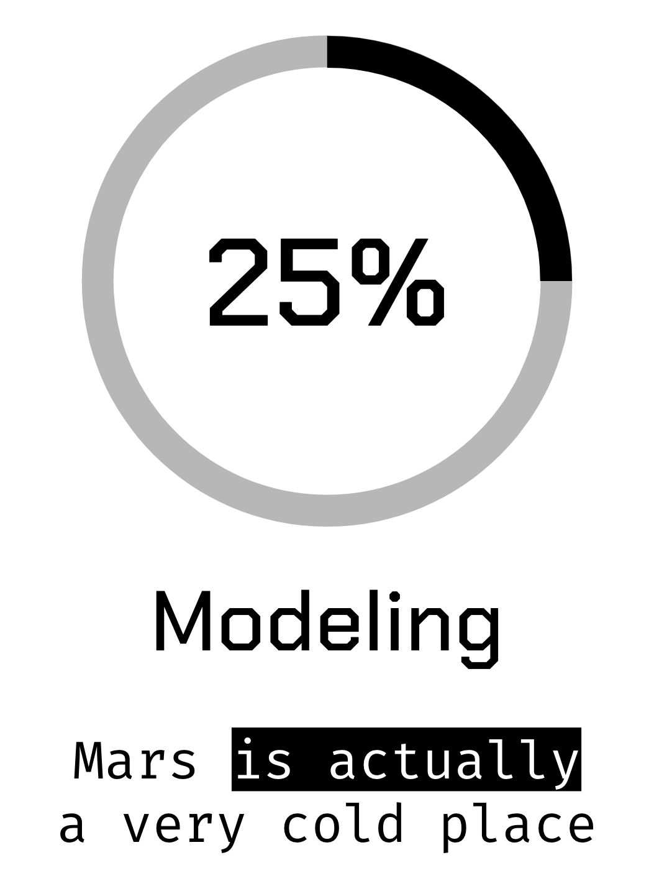
Studying app
You can replace the image on the screen with your own work. Just right-click on it and select “Replace image”

Slide 58
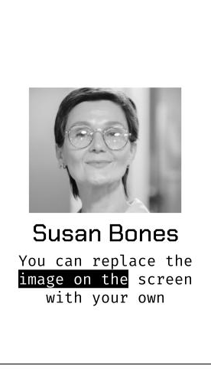
Messaging app
You can replace the image on the screen with your own work. Just right-click on it and select “Replace image”

Slide 59
Thanks!
Do you have any questions?
youremail@freepik.com
+91 620 421 838
yourwebsite.com
Please keep this slide for attribution

Slide 60
Alternative resources

Slide 61
Alternative resources
Did you like the resources on this template? Get them for free at our other websites:
Photos
Young woman browsing laptop on road trip
High angle of woman drawing at desk with laptop
Flat lay desk with laptop and glasses
Vectors
Black friday background with black and white elements
Modern cursor set
Multimedia icons
Set of white speech bubbles in pixel art style

Slide 62
Resources
Did you like the resources we used in this template? Get them for free at our other websites:
Photos
Laptop Free
White keyboard of modern laptop
Medium shot colleagues back to office
Vectors
Set of white speech bubbles in pixel art style
Pixel gaming youtube channel art
Pixel mouse cursors pointer, arrow and wait
Vector pixel mouse cursors over white
Vector pixel mouse cursors over white

Slide 63
Instructions for use
If you have a free account, in order to use this template, you must credit Slidesgo by keeping the Thanks slide. Please refer to the next slide to read the instructions for premium users.
As a Free user, you are allowed to:
- Modify this template.
- Use it for both personal and commercial projects.
You are not allowed to:
- Sublicense, sell or rent any of Slidesgo Content (or a modified version of Slidesgo Content).
- Distribute Slidesgo Content unless it has been expressly authorized by Slidesgo.
- Include Slidesgo Content in an online or offline database or file.
- Offer Slidesgo templates (or modified versions of Slidesgo templates) for download.
- Acquire the copyright of Slidesgo Content.
For more information about editing slides, please read our FAQs or visit Slidesgo School:
https://slidesgo.com/faqs and https://slidesgo.com/slidesgo-school

Slide 64
Instructions for use (premium users)
As a Premium user, you can use this template without attributing Slidesgo or keeping the "Thanks" slide.
You are allowed to:
Modify this template.
Use it for both personal and commercial purposes.
Hide or delete the “Thanks” slide and the mention to Slidesgo in the credits.
Share this template in an editable format with people who are not part of your team.
You are not allowed to:
Sublicense, sell or rent this Slidesgo Template (or a modified version of this Slidesgo Template).
Distribute this Slidesgo Template (or a modified version of this Slidesgo Template) or include it in a database or in any other product or service that offers downloadable images, icons or presentations that may be subject to distribution or resale.
Use any of the elements that are part of this Slidesgo Template in an isolated and separated way from this Template.
Register any of the elements that are part of this template as a trademark or logo, or register it as a work in an intellectual property registry or similar.
For more information about editing slides, please read our FAQs or visit Slidesgo School:
https://slidesgo.com/faqs and https://slidesgo.com/slidesgo-school

Slide 65
Fonts & colors used
This presentation has been made using the following fonts:
Chakra Petch
(https://fonts.google.com/specimen/Chakra+Petch)
Fira Code
(https://fonts.google.com/specimen/Fira+Code)
#000000
#ffffff
#666666
#b7b7b7

Slide 66
Storyset
Create your Story with our illustrated concepts. Choose the style you like the most, edit its colors, pick the background and layers you want to show and bring them to life with the animator panel! It will boost your presentation. Check out how it works.
Pana
Amico
Bro
Rafiki
Cuate

Slide 67
Use our editable graphic resources...
You can easily resize these resources without losing quality. To change the color, just ungroup the resource and click on the object you want to change. Then, click on the paint bucket and select the color you want. Group the resource again when you’re done. You can also look for more infographics on Slidesgo.

Slide 70
JANUARY
FEBRUARY
MARCH
APRIL
MAY
JUNE
PHASE 1
Task 1
Task 2
PHASE 2
Task 1
Task 2
JANUARY
FEBRUARY
MARCH
APRIL
PHASE 1
Task 1
Task 2

Slide 73
...and our sets of editable icons
You can resize these icons without losing quality.
You can change the stroke and fill color; just select the icon and click on the paint bucket/pen.
In Google Slides, you can also use Flaticon’s extension, allowing you to customize and add even more icons.

Slide 74
Educational Icons
Medical Icons

Slide 75
Business Icons
Teamwork Icons

Slide 76
Help & Support Icons
Avatar Icons

Slide 77
Creative Process Icons
Performing Arts Icons

Slide 78
Nature Icons

Slide 79
SEO & Marketing Icons

Slide 80


